Slide 1

Capstone Project
Supervised ML - classiﬁcation
Cardiovascular risk prediction
by
Deepak Dobal

Slide 2
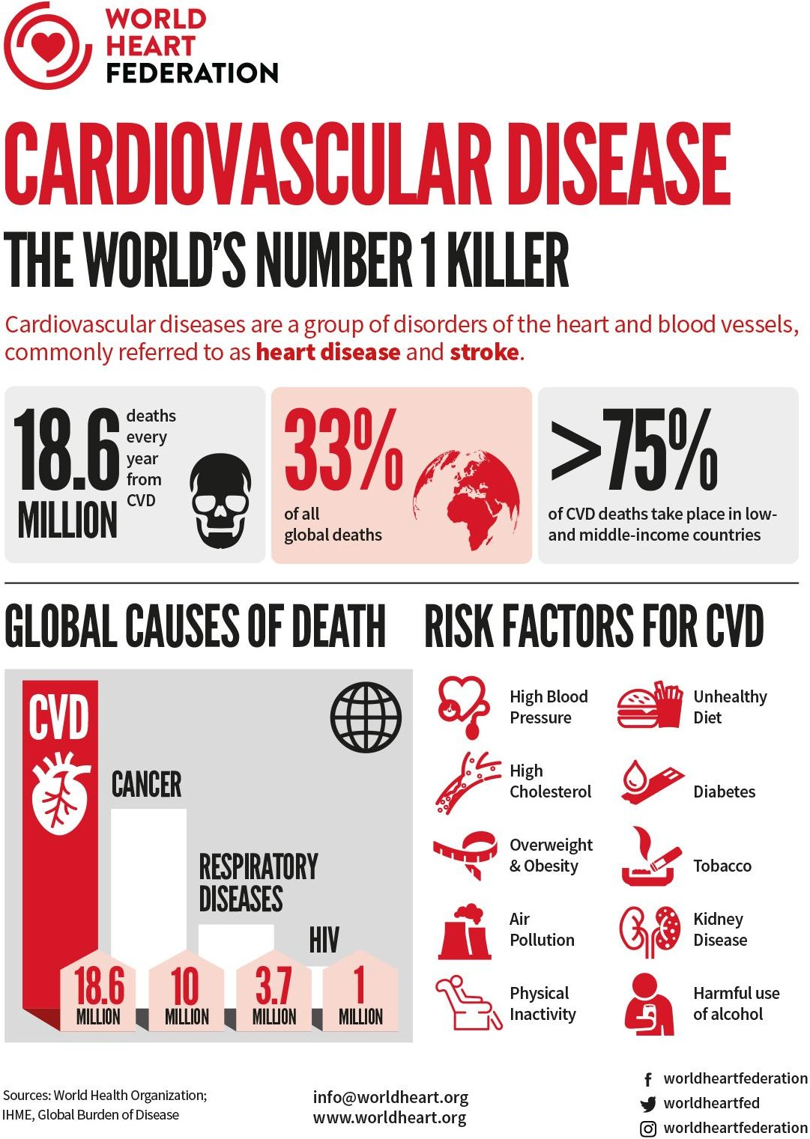
Problem statement:
Coronary heart diseases (CHDs) are the leading cause of death globally, taking an estimated 18.6 million lives each year, which accounts for 33% of all the global deaths.
Therefore It is important to detect cardiovascular diseases as early as possible so that management with counselling and medicines can begin.
Our main aim here is to predict if a patient has a ten year risk of future coronary heart diseases based on a set of metrics.

Slide 3
Understanding the data:
To increase the efficiency of our analysis we will first have to understand the data and also check if there are some corruptions in the data and if any found we will try to treat it.
The dataset is from an ongoing cardiovascular study on residents of the town of Framingham, Massachusetts. The dataset provides the patients’ information. It includes over 4,000 records and 15 attributes.
Each attribute(column) is a potential risk factor. These attributes include demographic, behavioral, and medical risk factors.
Now we will look at what each column means.

Slide 4
The columns involved:
Demographic:
Sex. Age.
Medical (Current):
Tot Chol. Sys BP. Dia BP. BMI. Heart rate. Glucose.
Behavioral:
is_smoking. Cigs Per Day.
Medical (history):
BP Meds. Prevalent Stroke. Prevalent Hyp. Diabetes.
Target variable Ten Year CHD

Slide 5
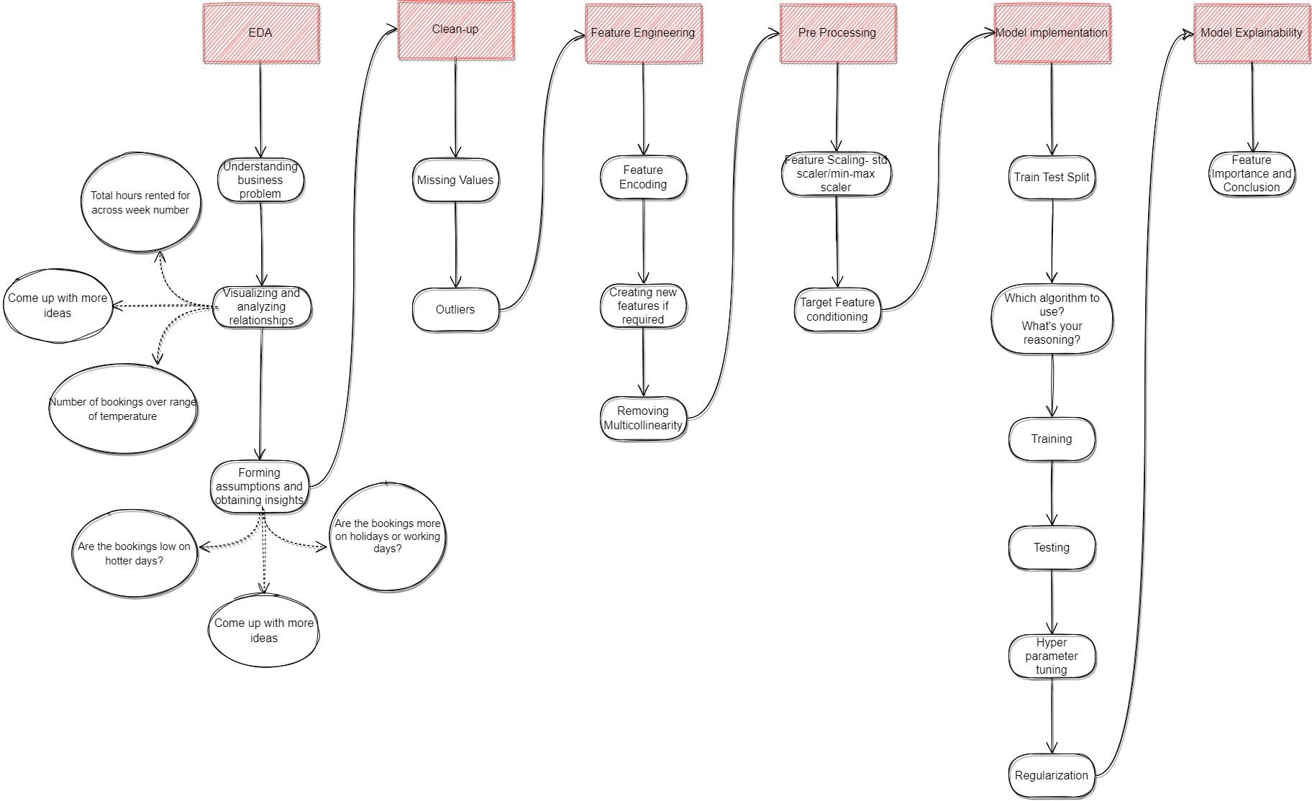
Project Flowchart:
Initial preparations.
EDA.
Clean up.
Feature Engineering.
Pre processing the data.
Model
implementation.
Model explainability.

Slide 6



1. Initial preparation:
Pandas for data manipulation, aggregation.
Matplotlib and Seaborn for visualization and behavior
with respect to the target variable
NumPy for computationally efficient operations
Scikit Learn for model training, model optimization, and
metrics calculation format.

Slide 7
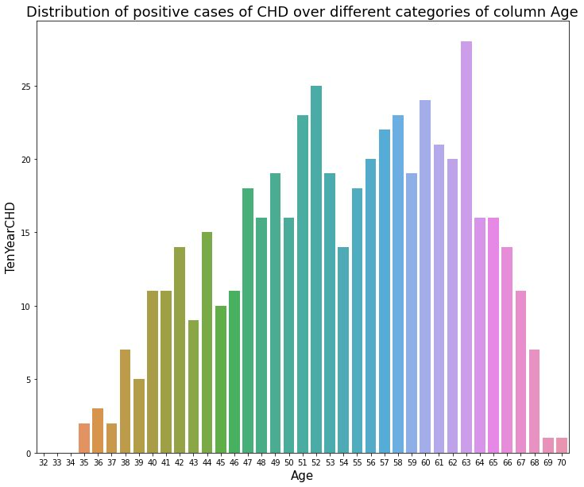
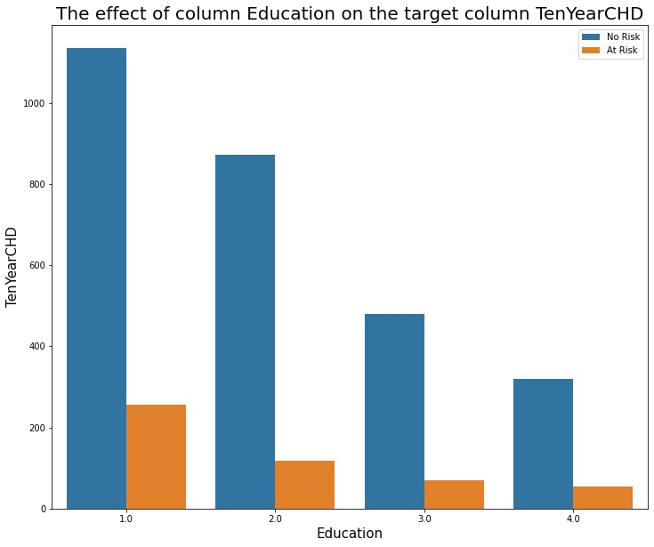
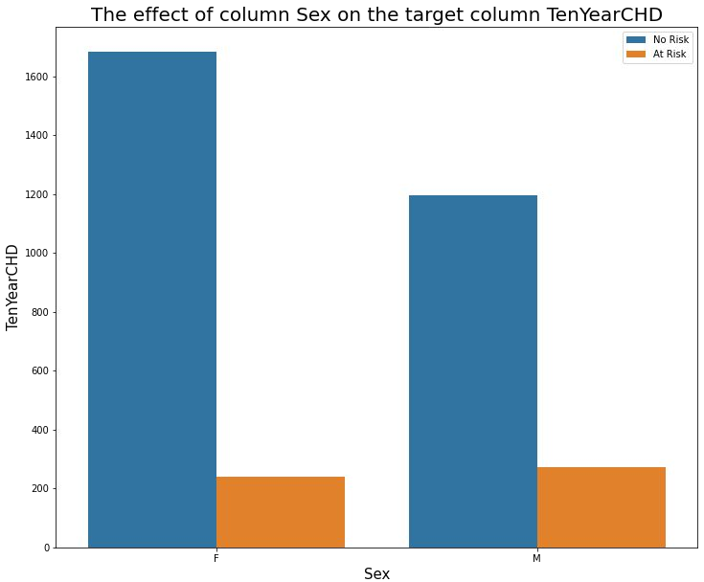
2. EDA:
In this step I have done exploratory data analysis on the data to see if I can find some valuable insights that can be directly applied to reduce the chances of having a positive CHD risk factor.
I have plotted each attribute against the target variable to see how it affects the target variable.

Slide 8
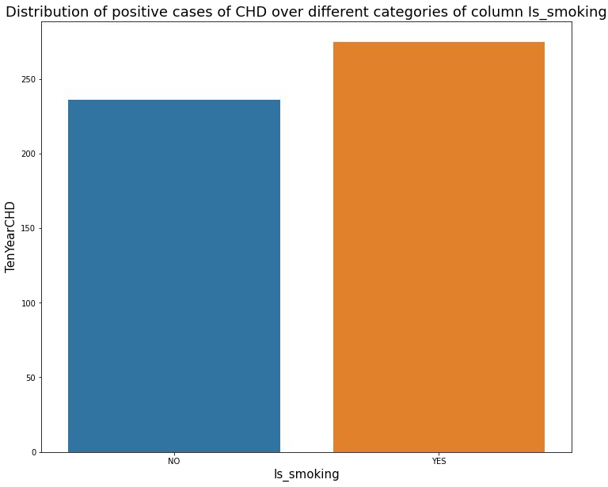
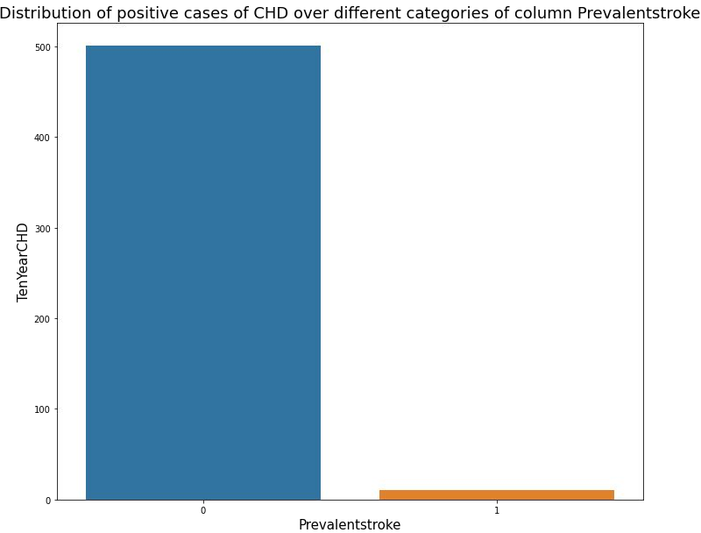
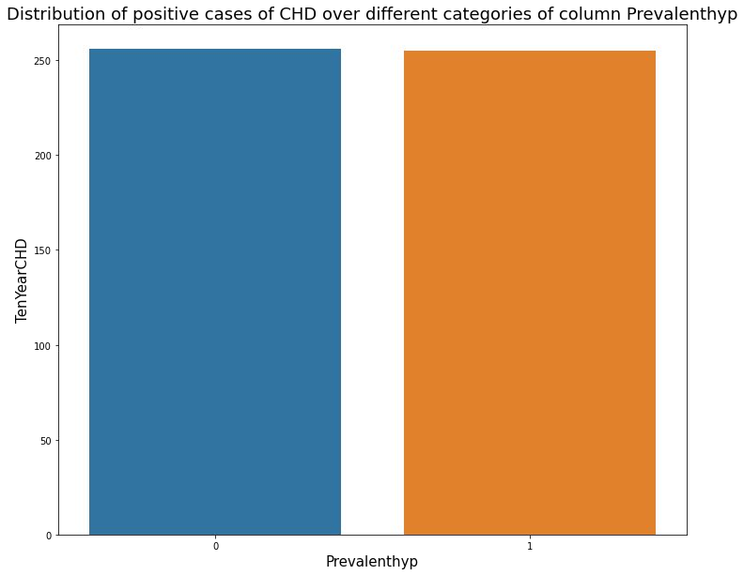
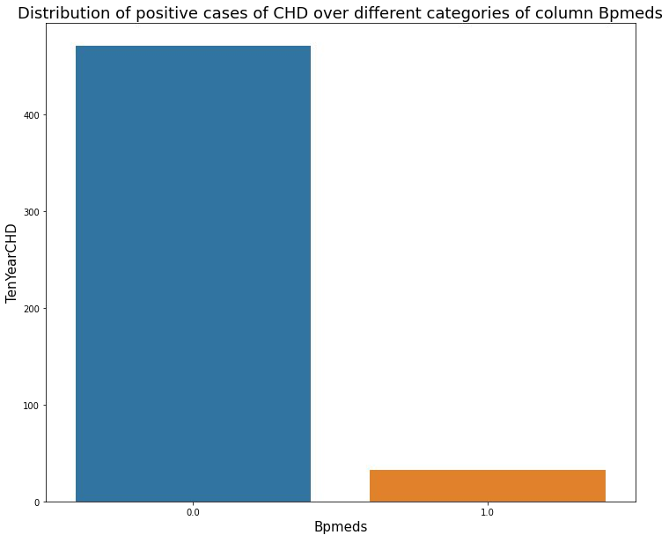
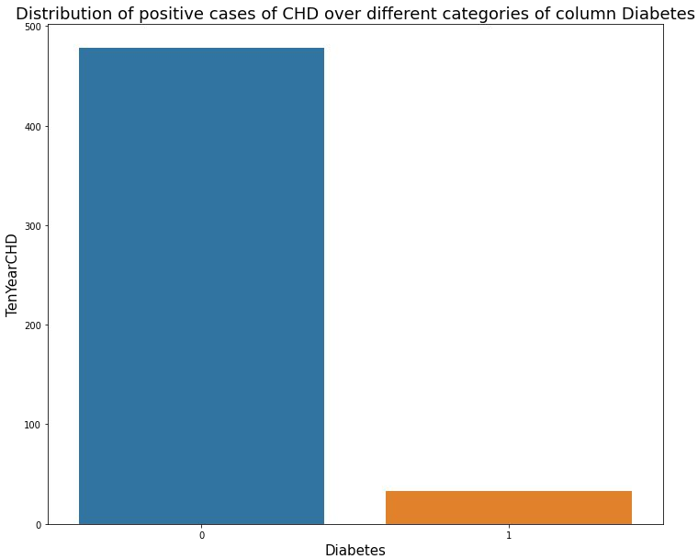
2. EDA(Contd):

Slide 9
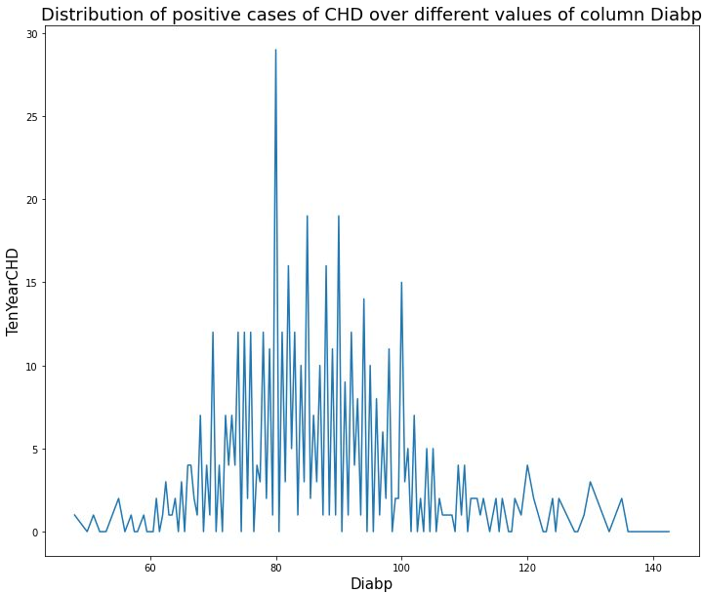
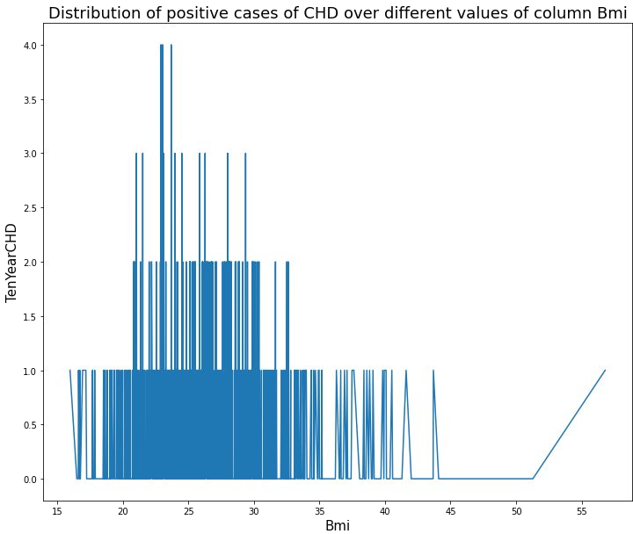
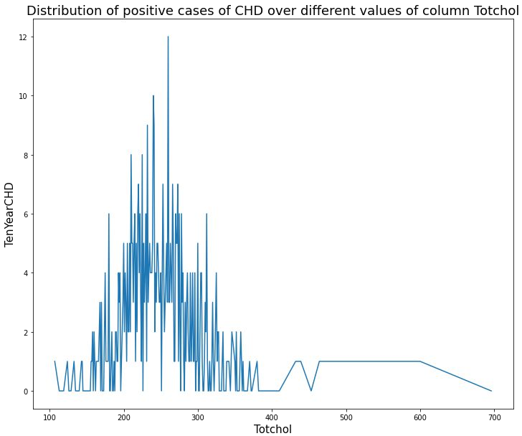
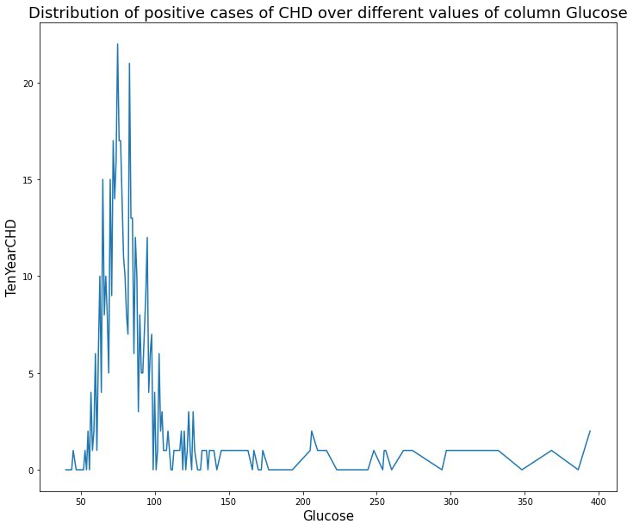
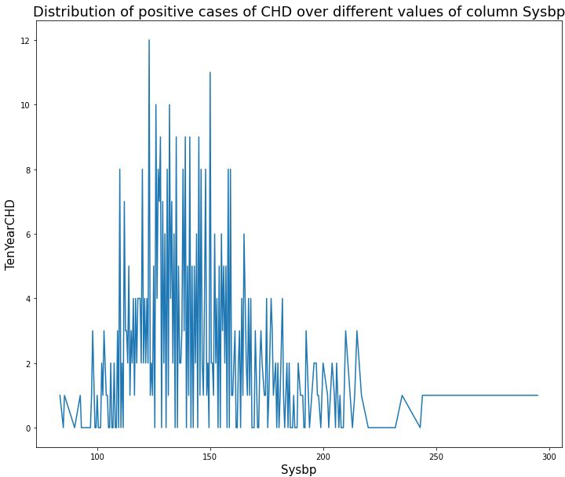
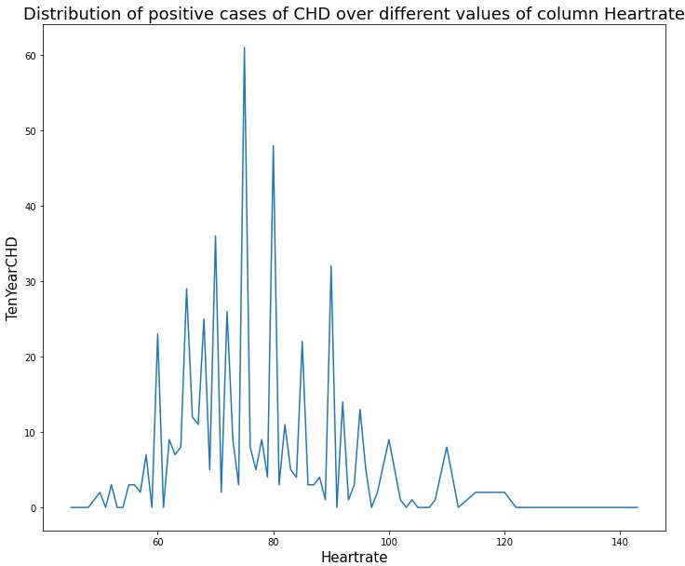
2. EDA(Contd):

Slide 10

3. Clean up:
Handling Null values: In this project the first step in Data cleaning is Handling the null values. Null values can affect the accuracy and quality of our ML models, therefore it is a good practice to handle null values. In this project I have used a combination of imputing and deleting the null values, where I have imputed columns with a great number of null values with the mean of that column and then deleted other observations that contain null values.
Handling duplicate values: Duplicate values can have adverse effects on our ML models, therefore we have to try and remove it. Luckily we don’t have any duplicate values in our data so we can move on to the next step in data cleaning.

Slide 11
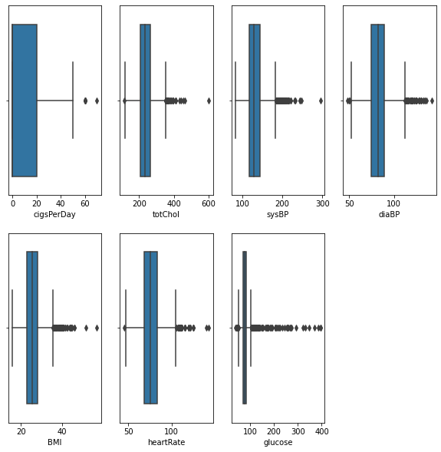
3. Clean up(Contd):
Removing Outliers: First of all we find the variables that may contain outliers, to detect this I’ve used the box plot offered by seaborn library.
Here we can see that many columns contain outliers, but they are all practically possible values.
Keeping in mind this idea of practicality, I will allow these outliers to stay in our data because they will impact our predictions.

Slide 12
4. Feature Engineering:
Feature Encoding: Machine learning models can only work with numerical values and therefore we have to turn the categorical columns to numeric columns, and this is achieved by feature encoding. In our dataset we have two such categorical columns, sex and is_smoking which we have to convert to numeric columns. I’ve used one hot encoding technique here.
Grouping columns for better understanding: There are multiple columns which can be combined to form single columns that convey the same information in a better and understandable way. There are 3 such pairs of columns, is_smoking and cigsPerDay which is combined to form SmokeLevel, diabetes and glucose which is combined to DiabetesLevel, and sysBP and diaBP which is combined to BPLevel.

Slide 13
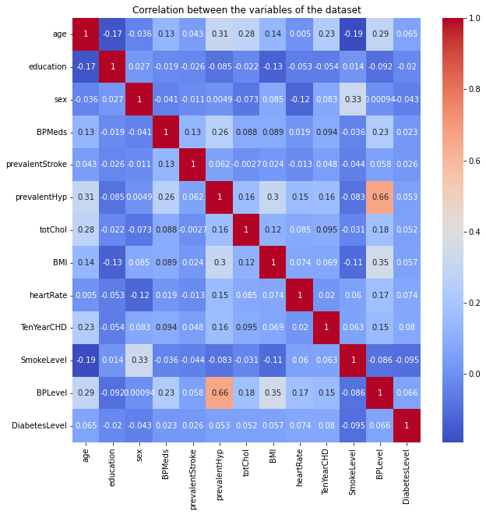
4. Feature Engineering(Contd):
Checking correlation for feature removal:
I’ve plotted the correlation matrix using the heatmap function offered by the seaborn library. As we can see, the prevalentHyp column is highly correlated to BPLevel, and also since it doesn’t really convey much information, I’ll just delete it.

Slide 14
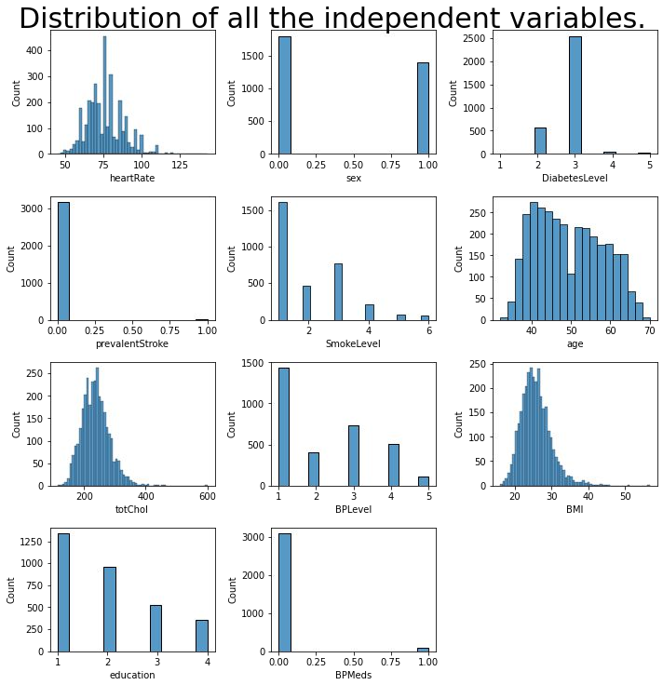
4. Feature Engineering(Contd):
Checking the distribution of the data: In this step I’ve just plotted the data in each individual column to check their distribution, using the histplot function offered by the seaborn library. The main reason I’ve done this is to check if the columns could really contribute to the prediction of the target variable. Using this step I’ve deleted the columns BPMeds, prevalentStroke and Education.

Slide 15
5. Pre Processing the data:
Dealing with class imbalance: Our target variable has two classes, 0-No risk and 1-At risk(Risk of having a CHD in the next 10 years). There is a high class imbalance here, that is the number of observations with 0 is significantly greater than the number of observations with 1 as the target variable. To solve this problem I’ve used the SMOTE(synthetic minority oversampling technique) technique. After this step the class imbalance is completely removed.
Splitting and scaling the data: In this step I’ve split the data into
the independent columns and the target variable and further into train and test set and then scaled the independent columns to avoid giving more weightage to columns that have higher values and low weightage to columns that have low numeric value.

Slide 16
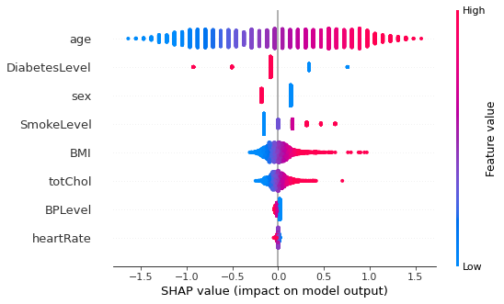
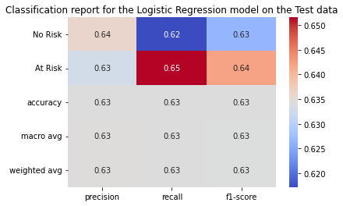
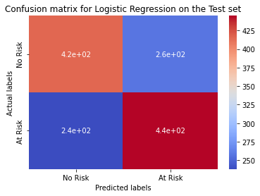
6&7. Model implementation and explainability:
These are two different processes in the flowchart, but for explaining purposes I’m clubbing the two into a single process.
Logistic regression:
ROCAUC score on test set = 0.634

Slide 17
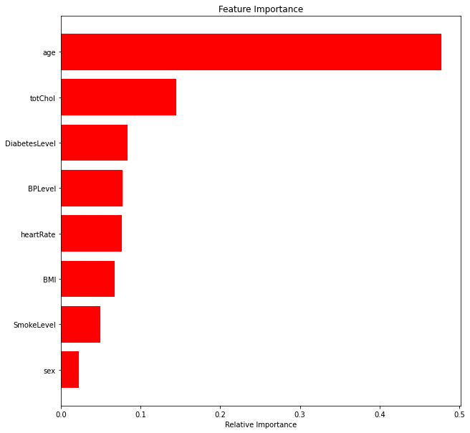
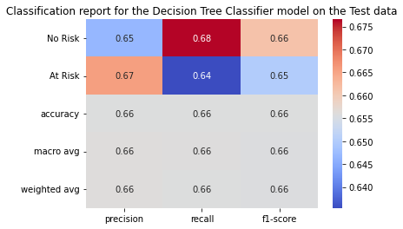
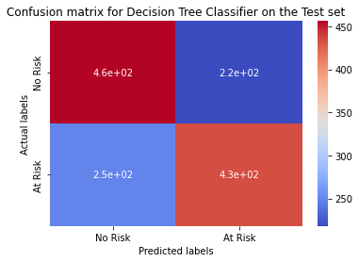
6&7. Model implementation and explainability(Contd):
Decision tree classifier :
ROCAUC score on test set = 0.655

Slide 18
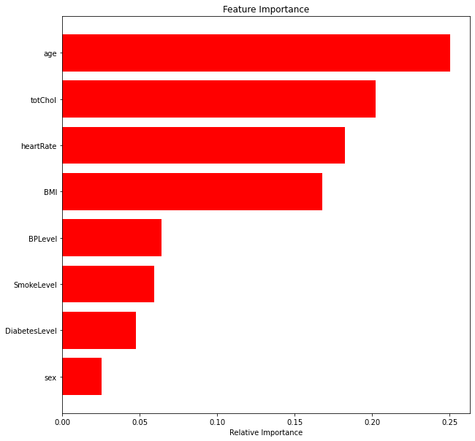
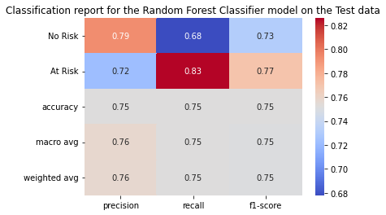
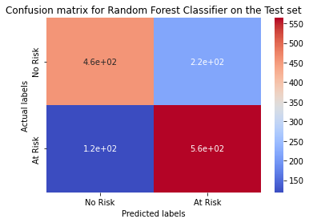
6&7. Model implementation and explainability(Contd):
Random Forest classifier : ROCAUC score on test set = 0.751

Slide 19
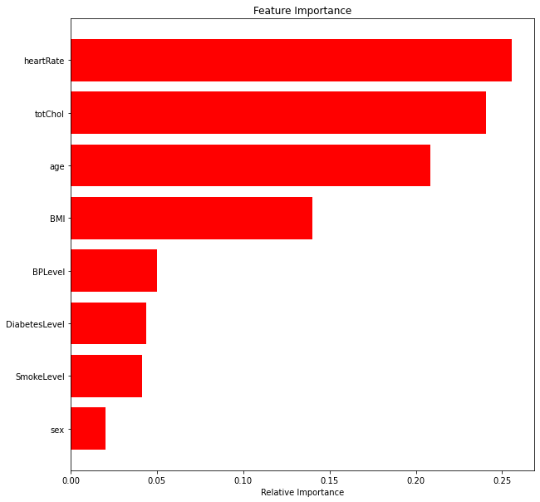
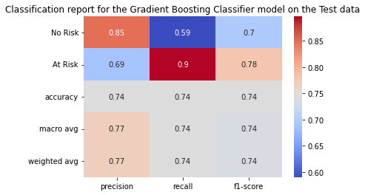
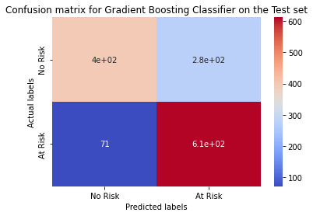
6&7. Model implementation and explainability(Contd):
Gradient Boosting classifier : ROCAUC score on test set = 0.743

Slide 20
Conclusion:
EDA insights:
The age group that is most likely to have a positive CHD risk factor is 47-65.
Education level is not a great factor to determine the CHD risk factor.
Males have a 7% greater chance of having a positive CHD risk factor.
Smoking increases the chances of a positive CHD risk factor by around 3%.
Having BP medications increases the chances of a positive CHD risk factor by around 19%.
Having a prevalent stroke increases the chances of a positive CHD risk factor by around 31%.
Prevalent Hypertension increases the chances of a positive CHD risk factor by around 13%.
Diabetes increases the chances of a positive CHD risk factor by around 24%.

Slide 21
Conclusion(Contd):
Results from ML models:
Logistic regression gives a ROCAUC score of 0.6365 on the testing set. This is worst performing model.
Decision tree model gives a ROCAUC score of 0.6617 on the testing set.
Random Forest Classifier model gives a ROCAUC score of 0.7584 on the testing set. This is the best performing model.
Gradient Boosting Classifier model gives a ROCAUC score of 0.7416 on the testing set.
Classification report and confusion matrix has been plotted for all the models.
Model explainability has been achieved by SHAP library's summary plot and an attribute called feature_importances_ of the tree based algorithms.
Total cholesterol and age are the two most important factors to predict the CHD risk factor.
Challenges faced:
Feature engineering.
Handling class imbalance.
Choosing model explainability techniques.
Running the slow Gradient Boosting Classifier.

Slide 22
THANK YOU

